Slide 1
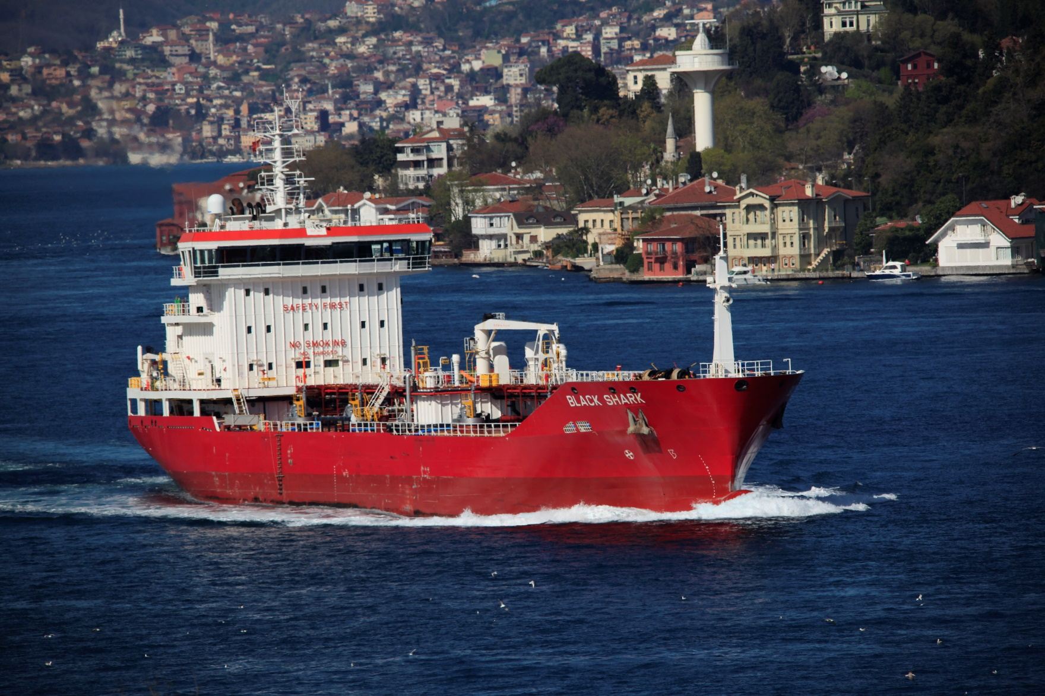
Black Shark
DWT 8.475
6.438 at 98%m³ Bitumen/Asphalt/Pitch Carrier

Slide 2
Technical characteristics
Lenght overall | mt. 117
Lenght between perpendiculars | mt. 109,40
Breadth | mt. 19,0
Moulded depth (from keel to main deck) | mt. 10,25
Summer draft | mt. 7,50
D.W.T. | tonn. 8.475

Slide 3
Technical characteristics
Cargoes
Pitch 250°
Coaltar
Dirty cargoes
over 60° flashpoint
Bitumen
Asphalt

Slide 4
Technical characteristics
Segregated ballast capacity | 3.622,12 m³
Bunker capacity | f.o. m³ 478,2 – gasoil m³ 81,62 at 100%
MAIN ENGINE | 1 – Wartsila 9L26B2
Service speed | 12 knots
Max speed | 13 knots
Alternative propulsion System 7 knots
Green Star notation

Slide 5
Points of STRENGHT
High heating capacity 250°
Imo II
Stern line
Shallow draft
Full automation
Bow thruster
High bridge visibility
Vapour return line
Green star notation
Alternative propulsion system
Independent tanks with high insulation

Slide 6
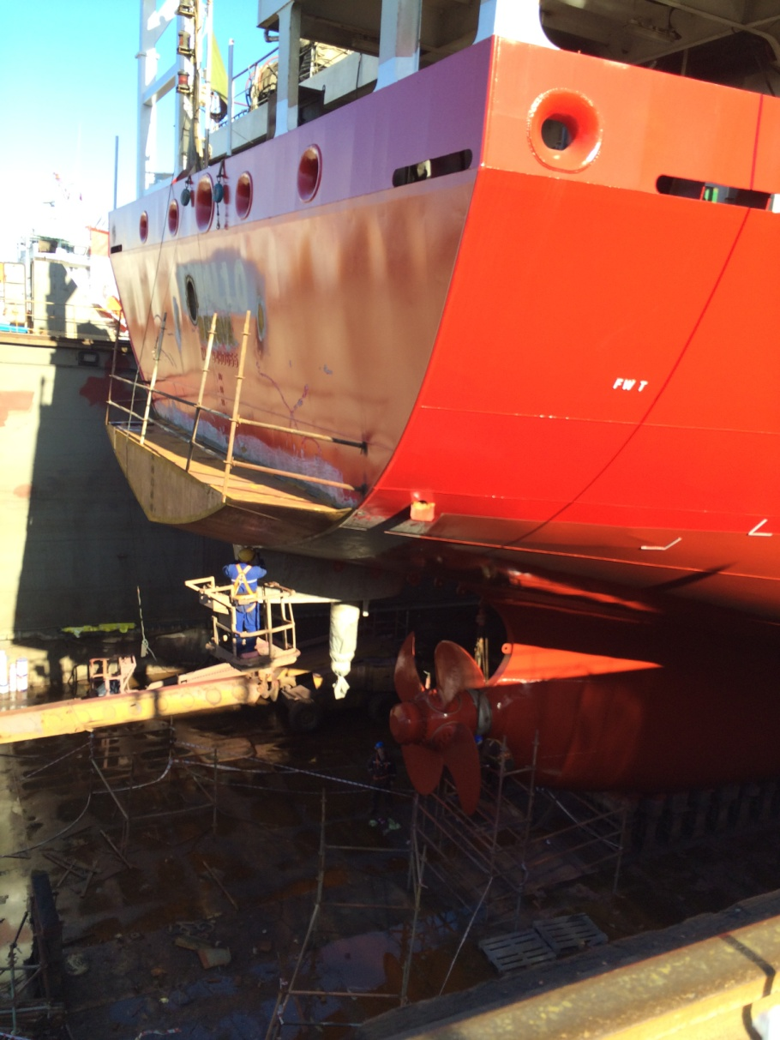
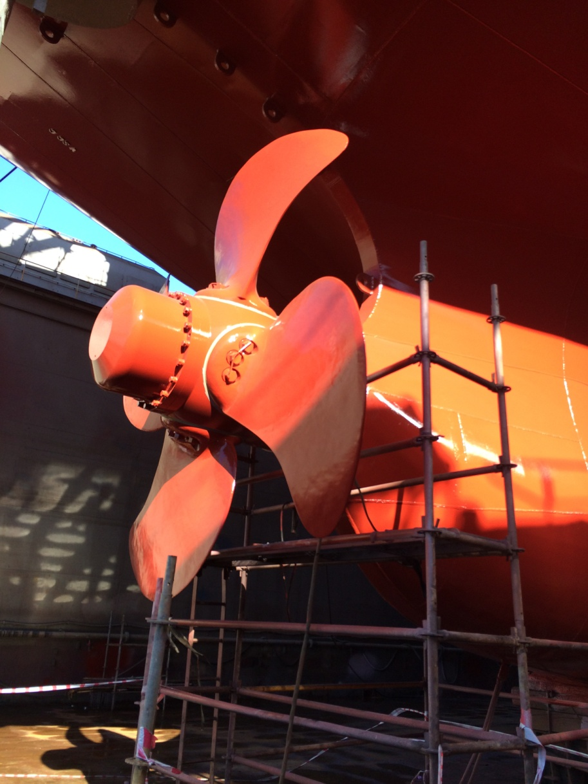
Black Shark - upgrading in Turkey

Slide 7
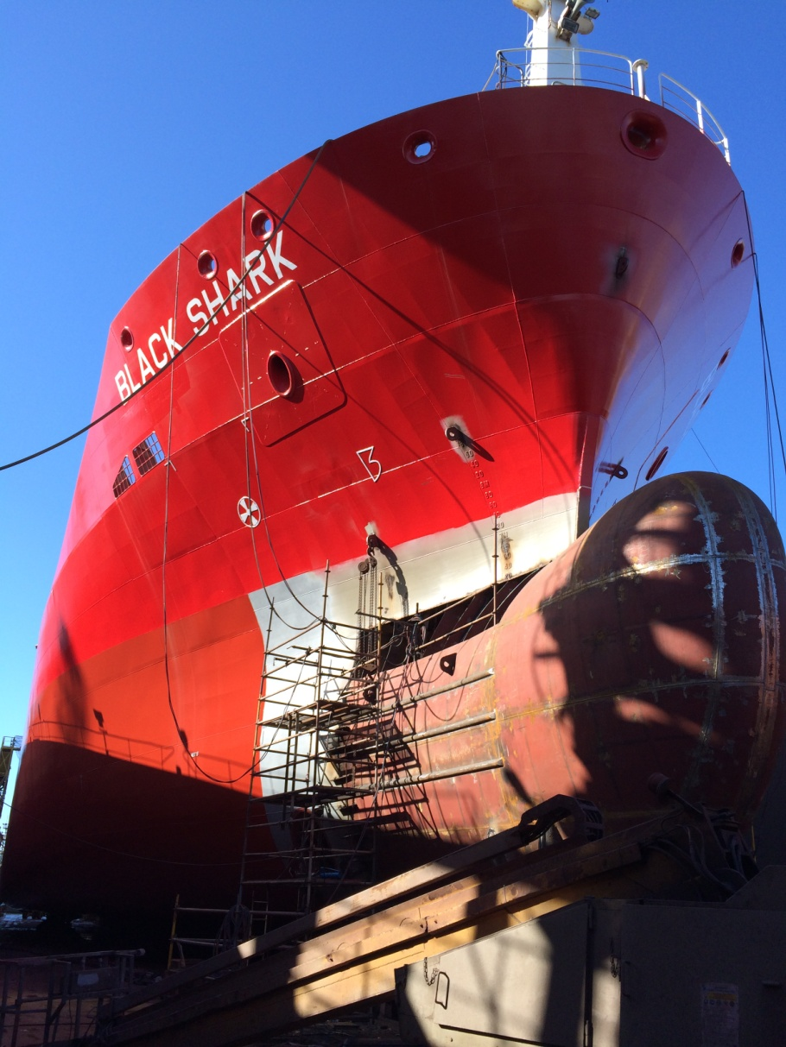
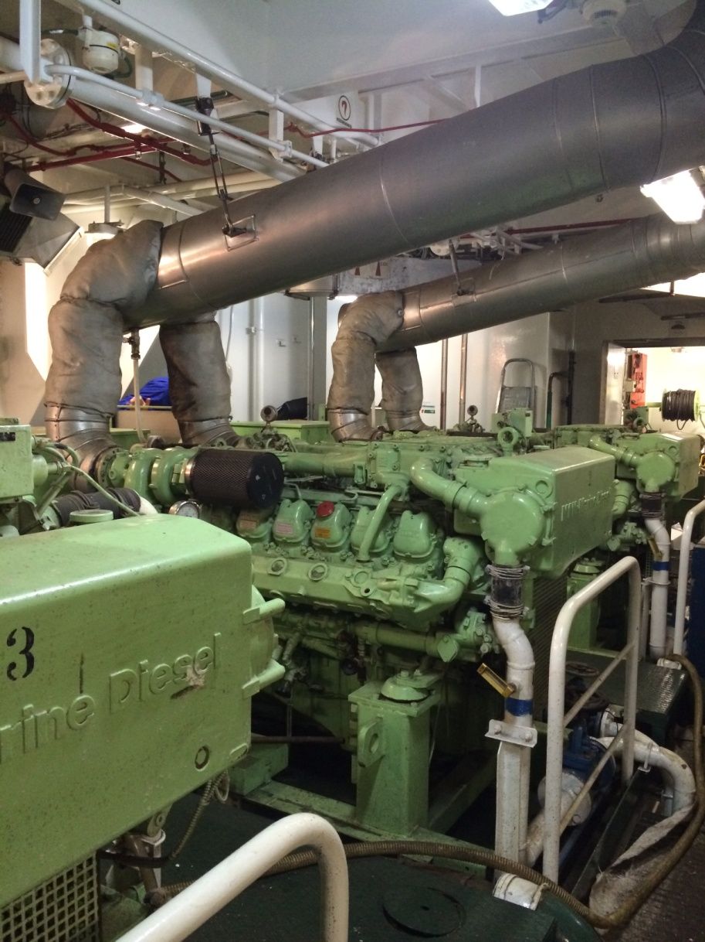

Slide 8
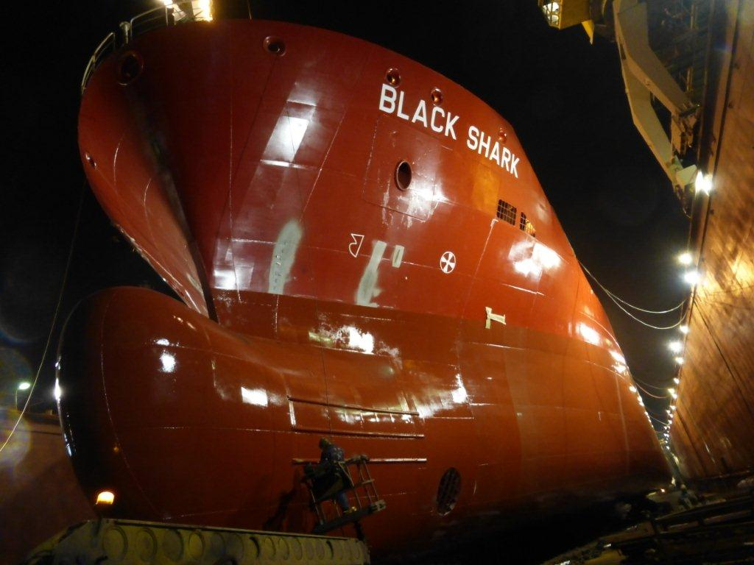
Black Shark - upgrading in Turkey

Slide 9
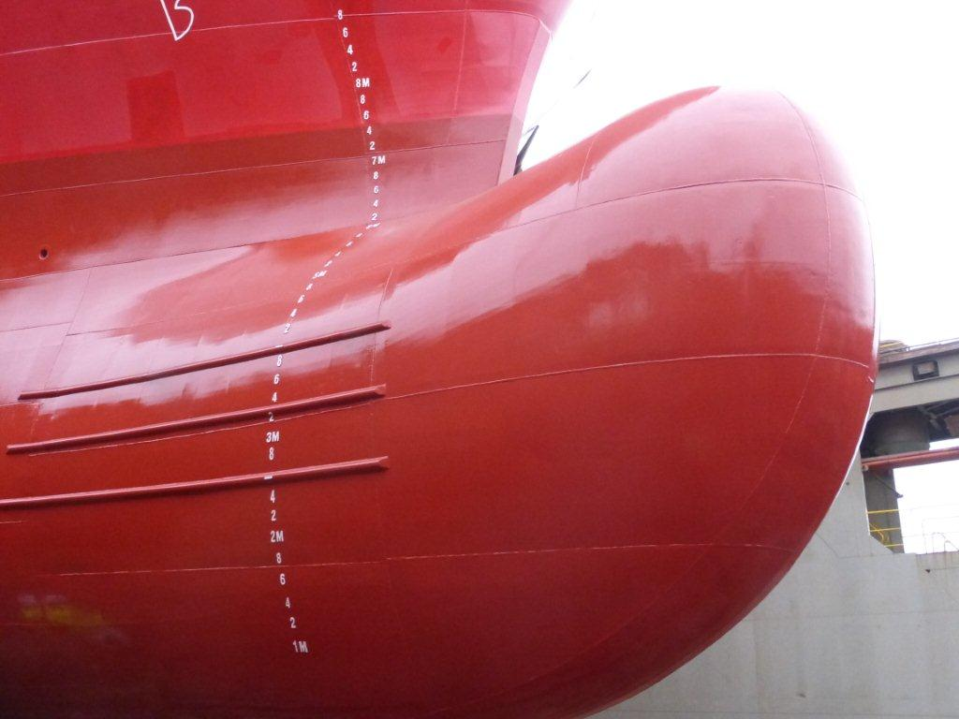
Black Shark - upgrading in Turkey

Slide 10
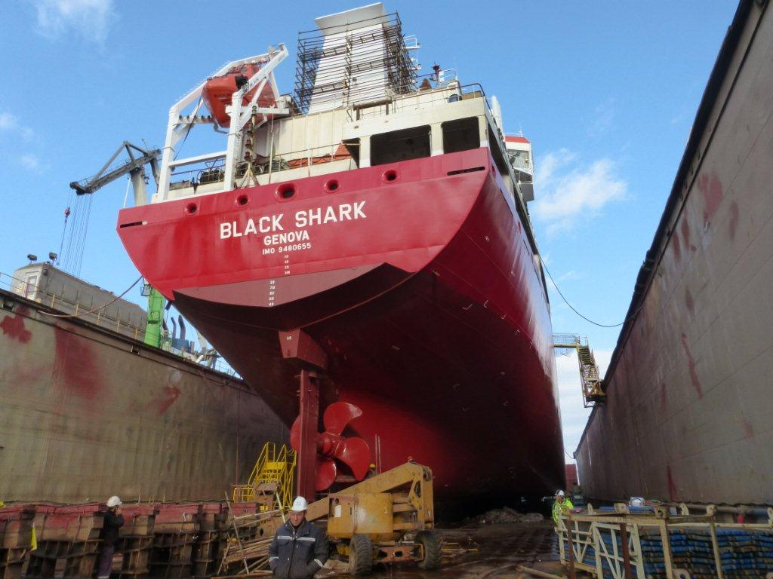
Black Shark - upgrading in Turkey

Slide 11
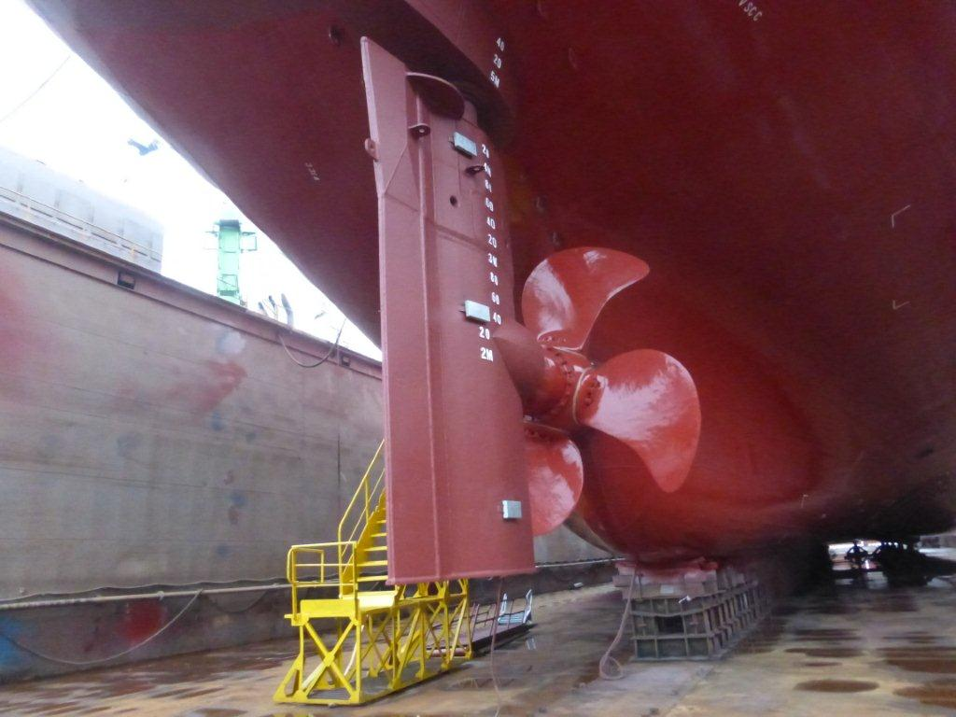
Black Shark - upgrading in Turkey

Slide 12
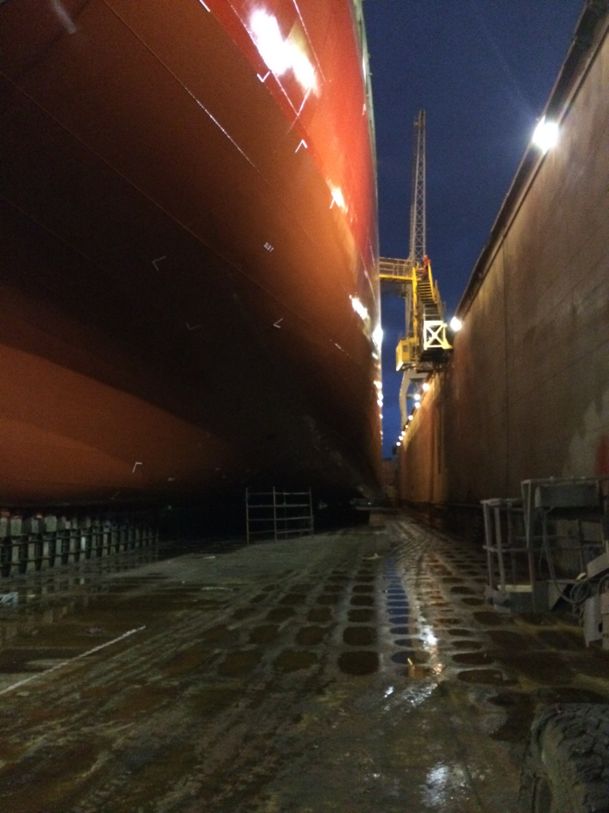

Slide 13
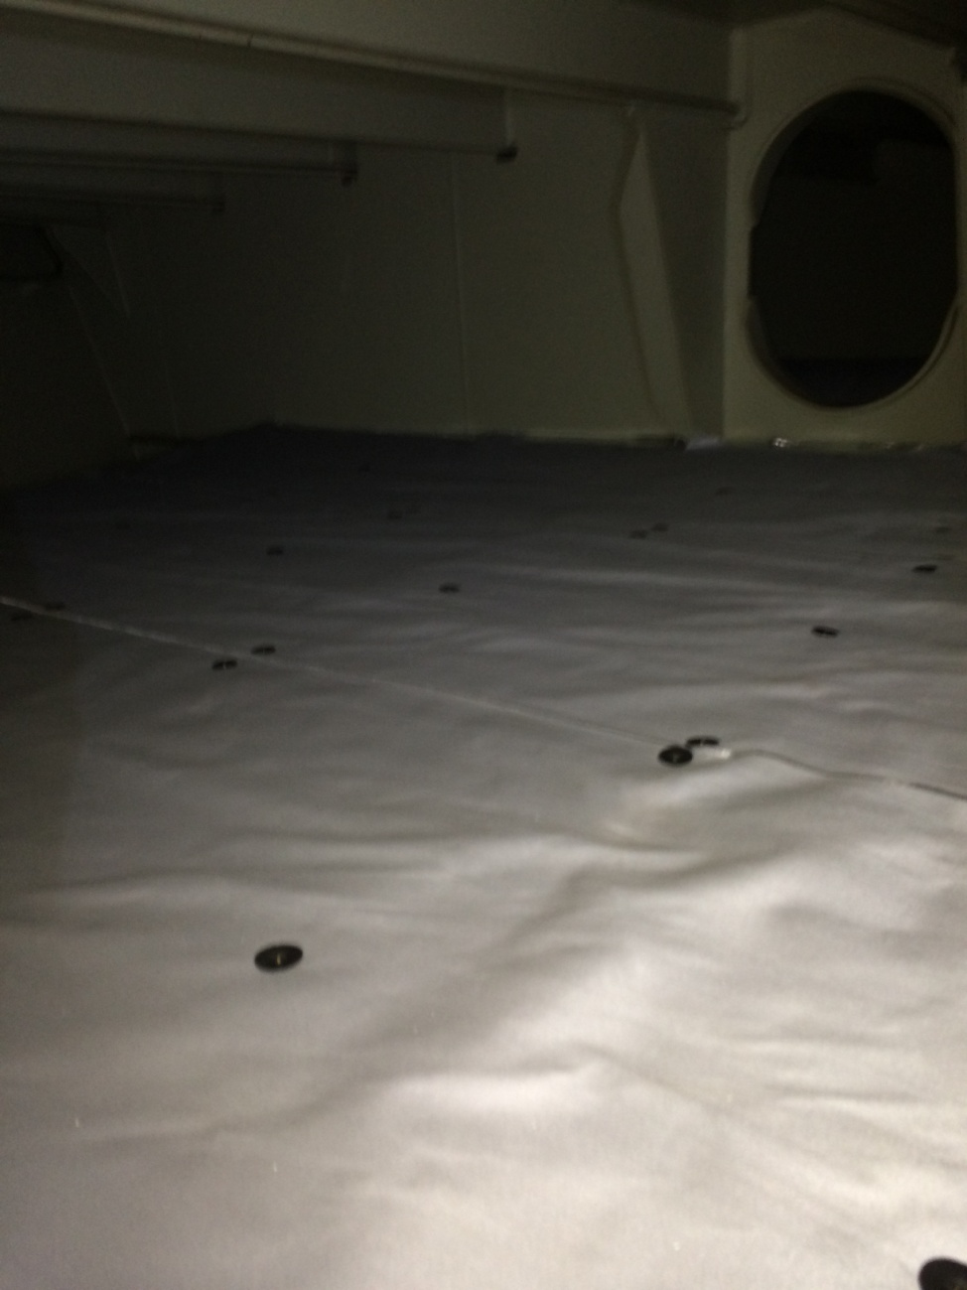
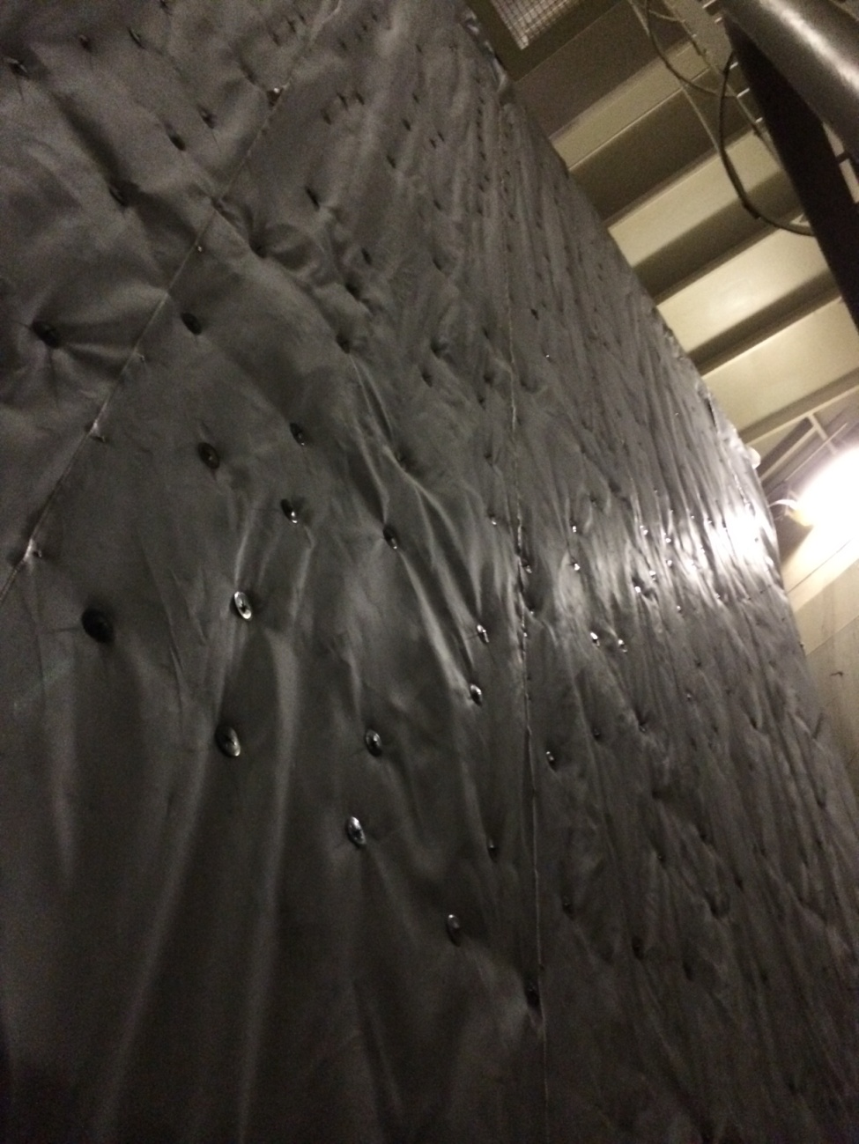

Slide 14
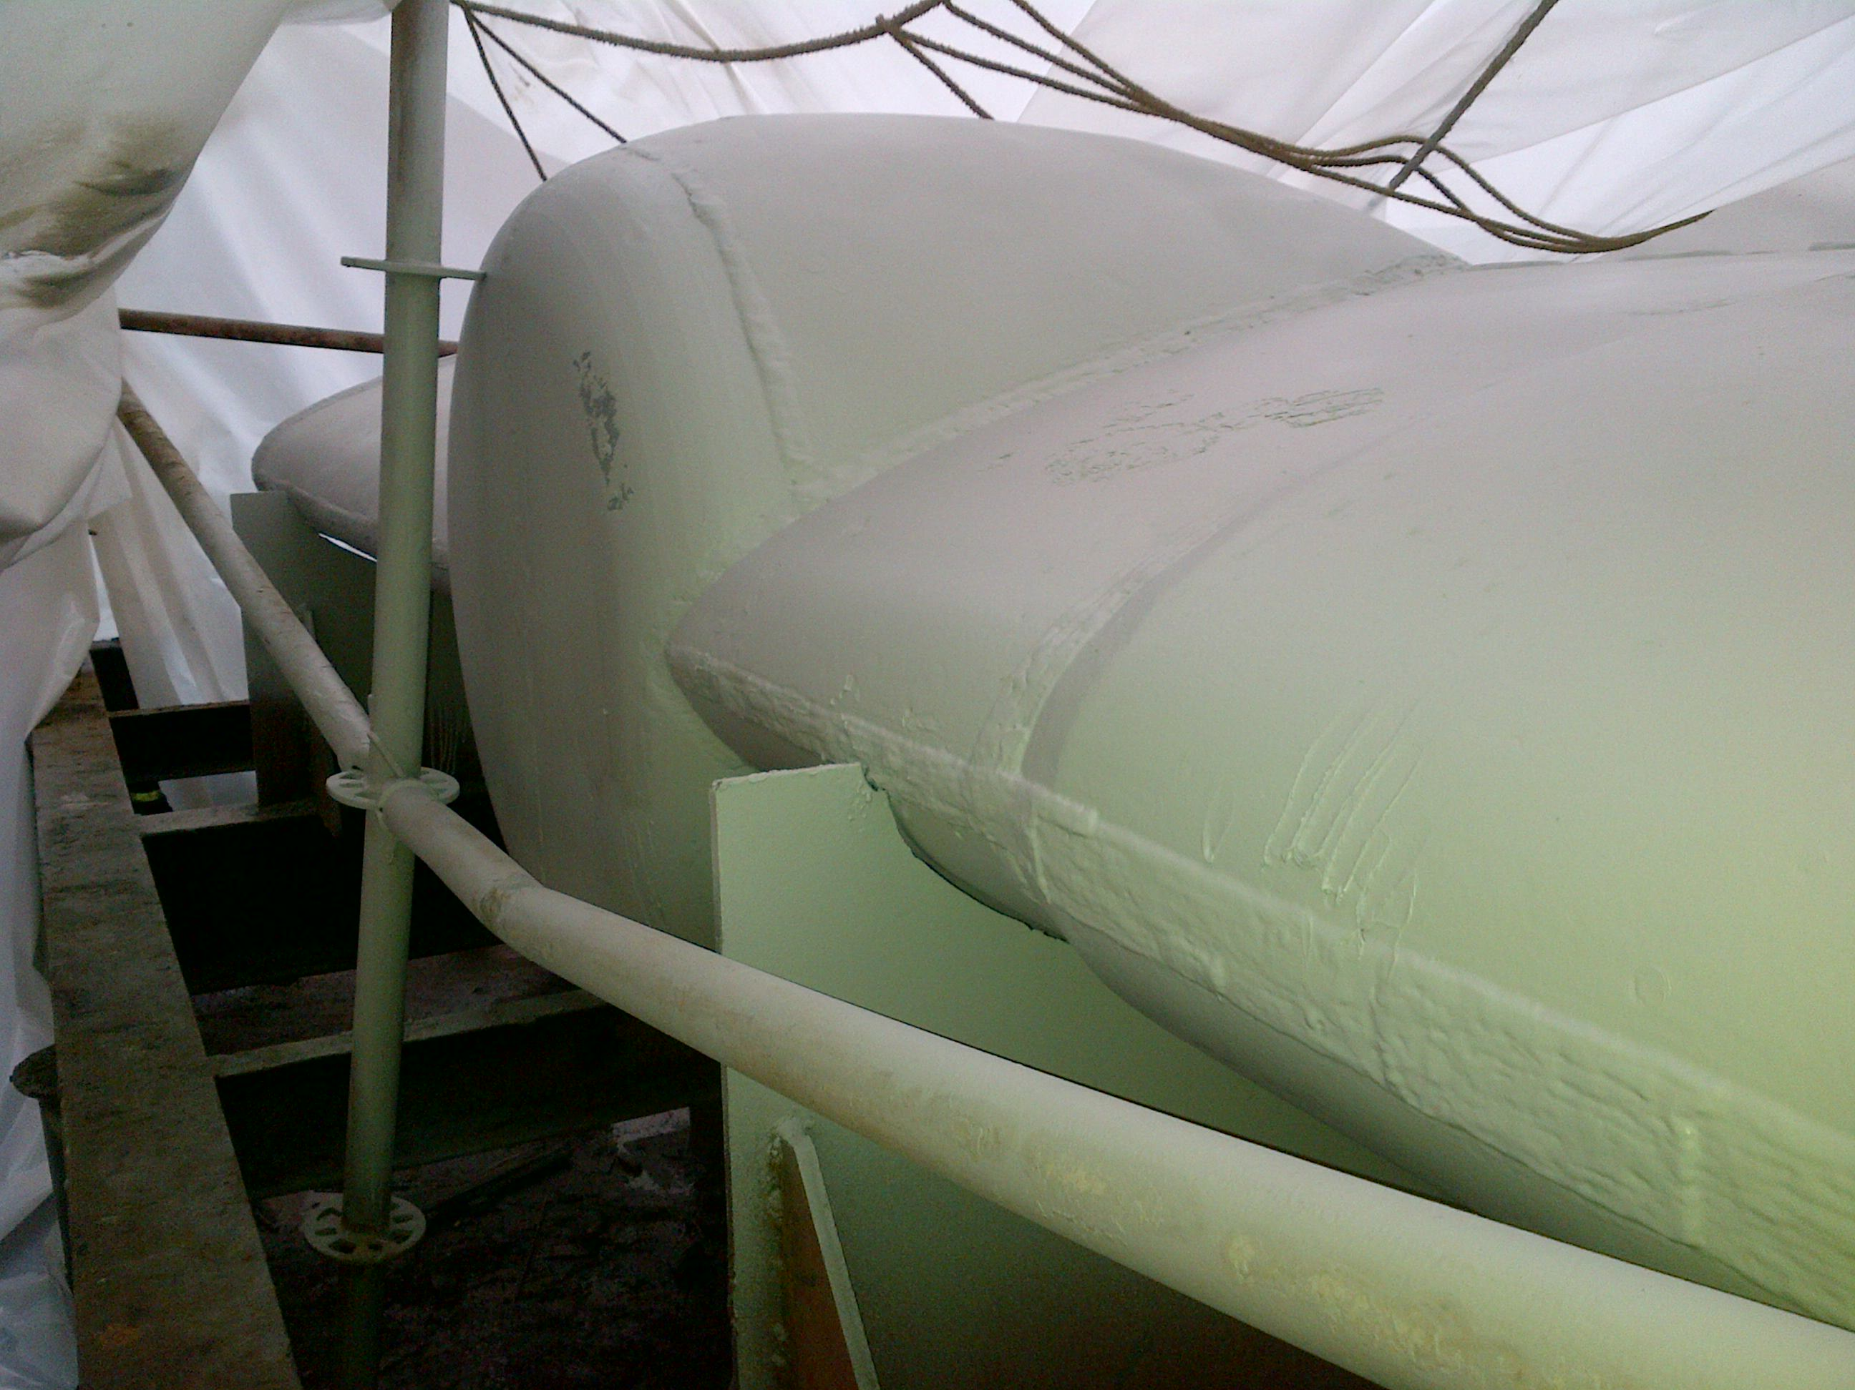

Slide 15
“THE END” MEDITERRANEA di NAVIGAZIONE S.p.A.
Piazza Caduti sul Lavoro n.3
48122 Ravenna
Italy
www.mediterraneanav.it
mediterranea@mediterraneanav.it

