Slide 1
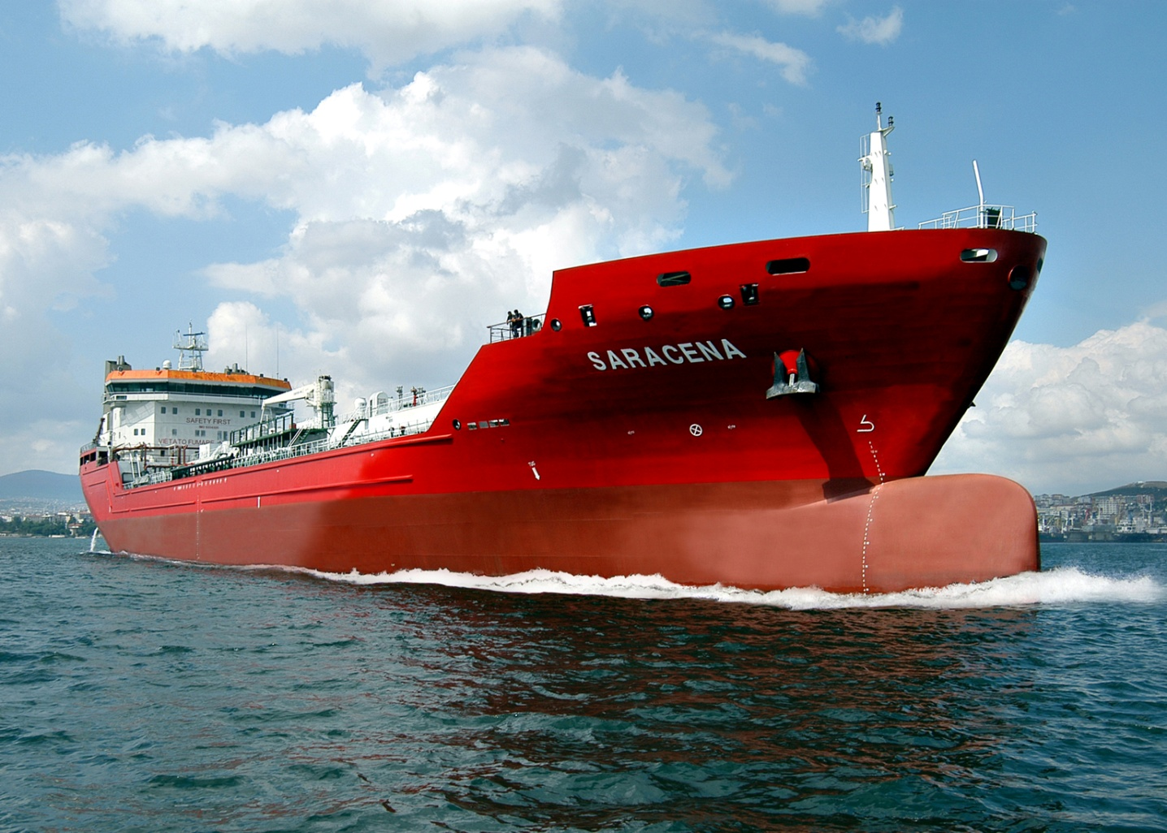
MEDITERRANEA DI NAVIGAZIONE SPA
M/T SARACENA
Oil Chemical Tanker

Slide 2
Technical characteristics Saracena
Lenght overall |  |  |  | mt. 153,70
Lenght between perpendiculars |  |  |  | mt. 144,20
Breadth |  |  |  | mt. 25,60
Moulded depth (from keel to main deck) |  |  |  | mt. 12,10
Scantling draft |  |  |  | mt. 8,88
D.W.T. |  |  |  | tonn. 20.500

Slide 3
Technical characteristics
Ballast capacity |  | m³ 9.298
Bunker capacity |  | High f.o. m³ 971– gasoil m³ 194
Main Engine |  | n.2 MAK x 3.000 kW each
Service speed |  | 14 knots
I.G.S. |  | 3.000 m³/h N2 1600 m3/h

Slide 4
POINTS OF STRENGHT
Ice Class 1°, Double Class RINA e ABS, Long Life criteria by RINA and ABS, Clean sea, Clean Air, Green Star, IMO II
30 years Life
Shallow draft
Winterisation (-35°C)
Special design for low grade temperature navigation: for outside air temp. of -35°C
Twin engine, twin propeller, twin rudder
IGS fitted
Full redundancy

Slide 5
POINTS OF STRENGHT
Bow thruster 750 kW hydraulic driven
High mooring retention 420 Tonns
Covered mooring area
Heated PV Valves
Stern line
Low consumption
Eco speed 10 knots 12,5 tons
Full automation
High manoeuvrability
Low residual 50 lt in cargo tank

Slide 6
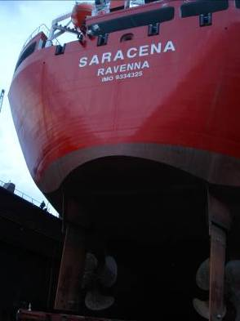
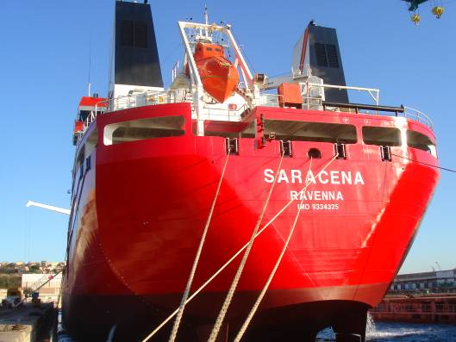
M/t Saracena

Slide 7
M/t Saracena

Slide 8
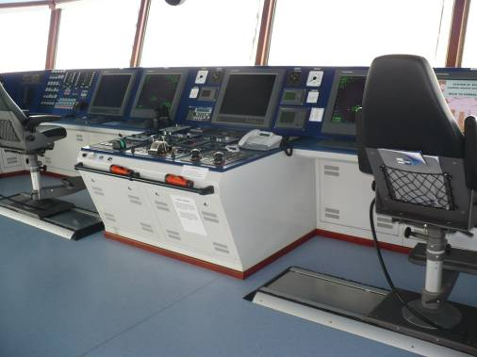
M/t Saracena

Slide 9
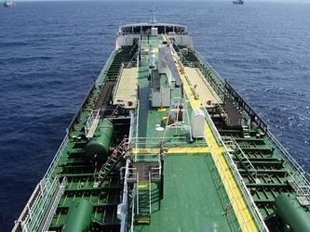
M/t Saracena

Slide 10
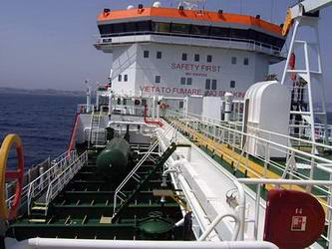
M/t Saracena

Slide 11
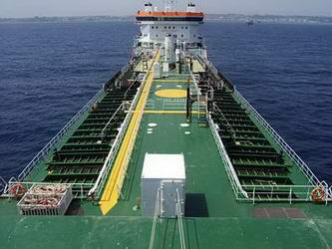
M/t Saracena

Slide 12
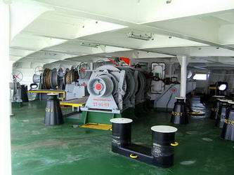
M/t Saracena

Slide 13
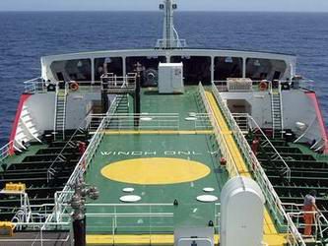
M/t Saracena

Slide 14
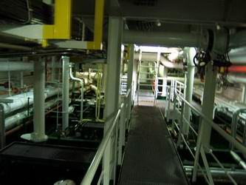
M/t Saracena

Slide 15
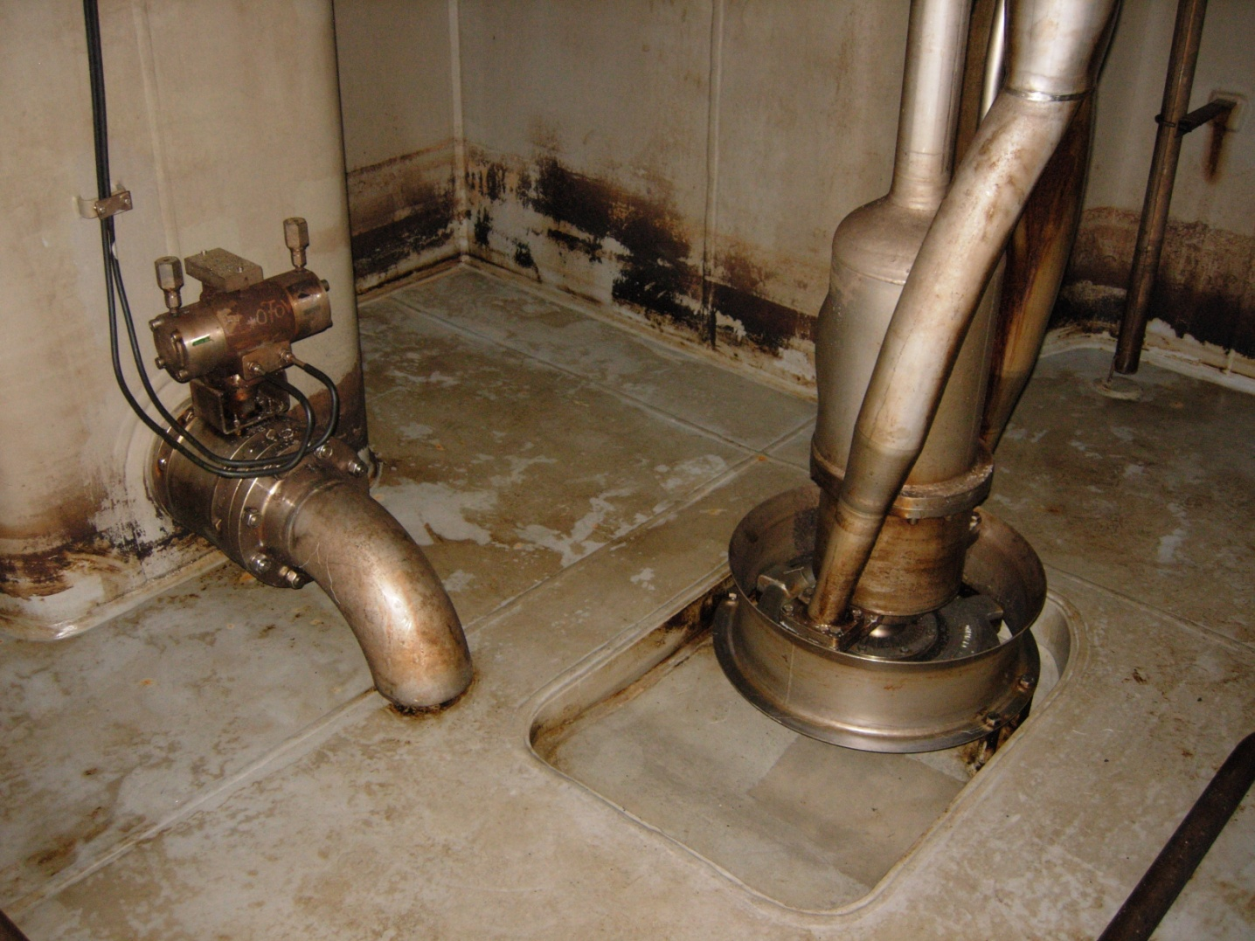
M/t Saracena

Slide 16
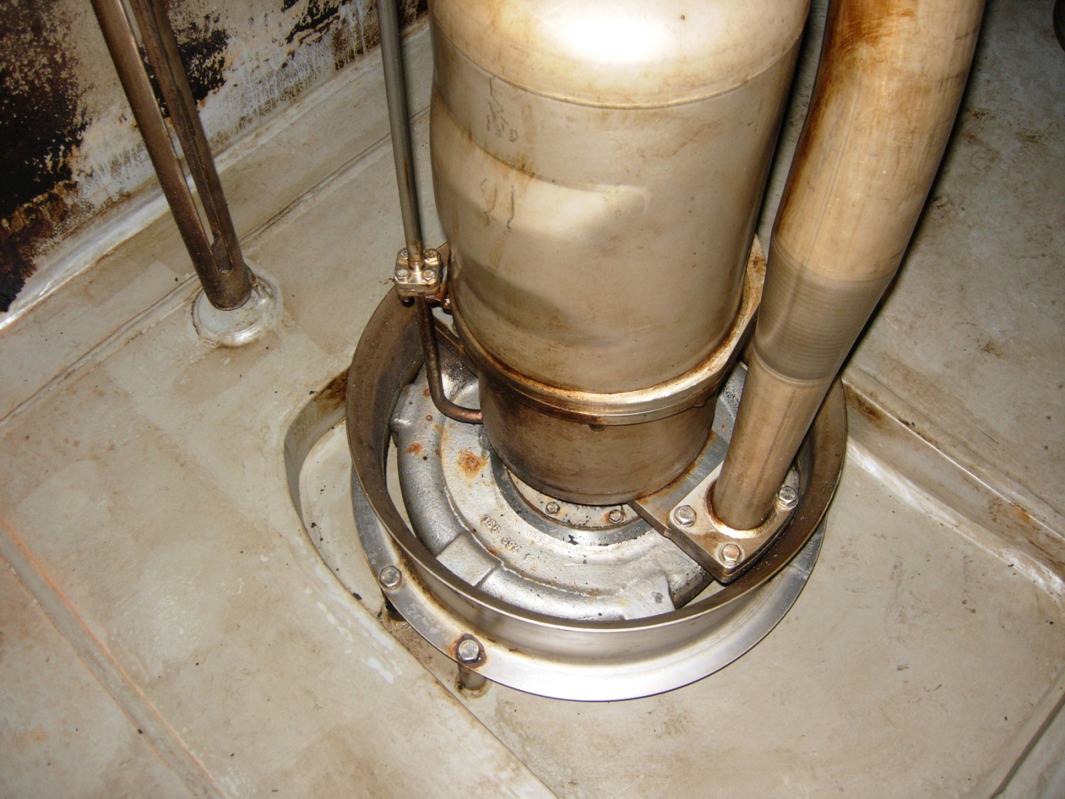
M/t Saracena

Slide 17
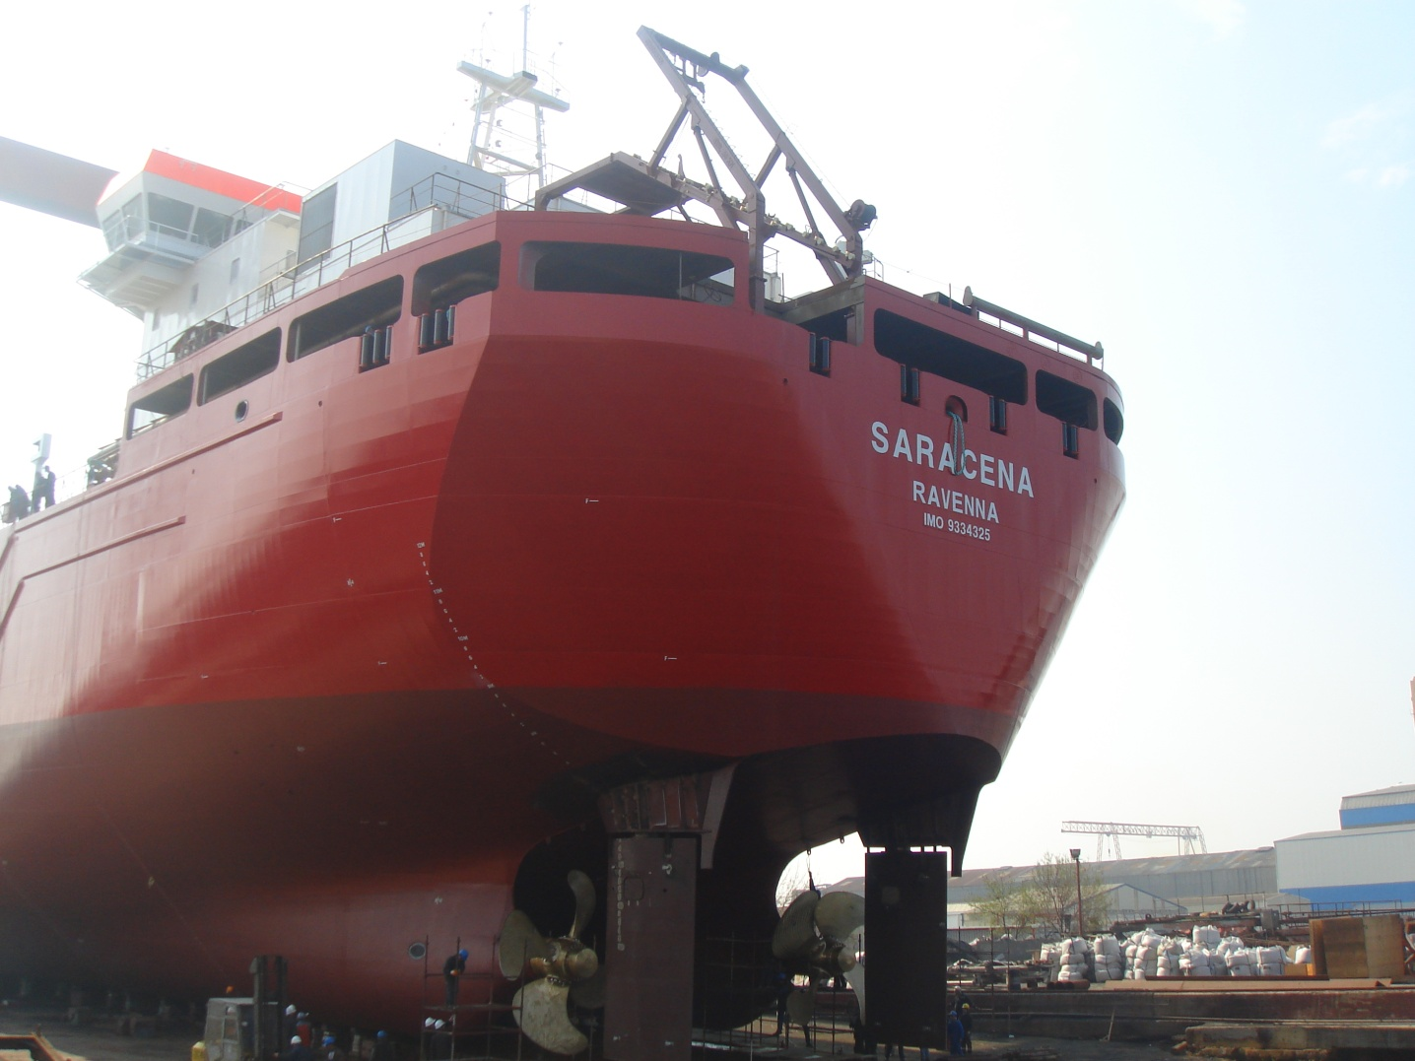
M/t Saracena

Slide 18
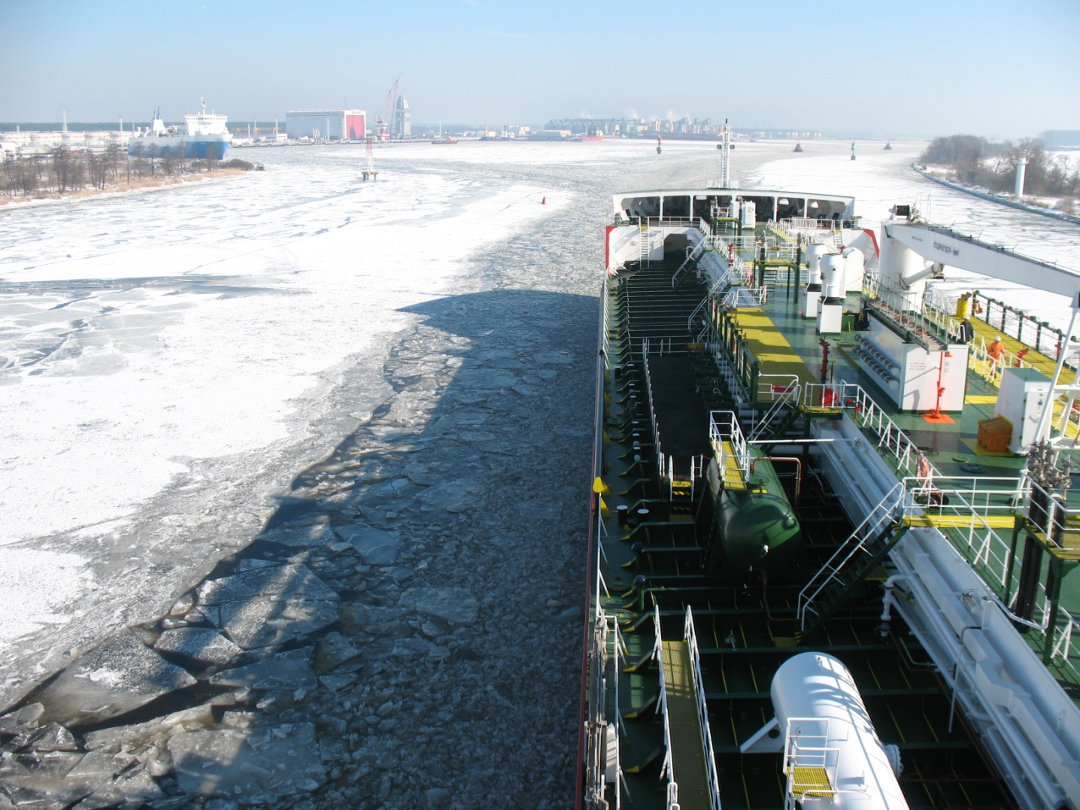
M/t Saracena

Slide 19
Mediterranea di Navigazione S.p.A.
Piazza Caduti sul Lavoro, 3 48100 Ravenna (RA) Italy
www.mediterraneanav.it mediterranea@mediterraneanav.it

