Slide 1
M/t NORMANNA
2016
CAP 1
HULL STRUCTURE
HULL AND CARGO MACHINERY, FITTINGS AND SYSTEMS
PROPULSION AND AUXILIARIES MACHINERY FITTINGS AND SYSTEMS

Slide 2
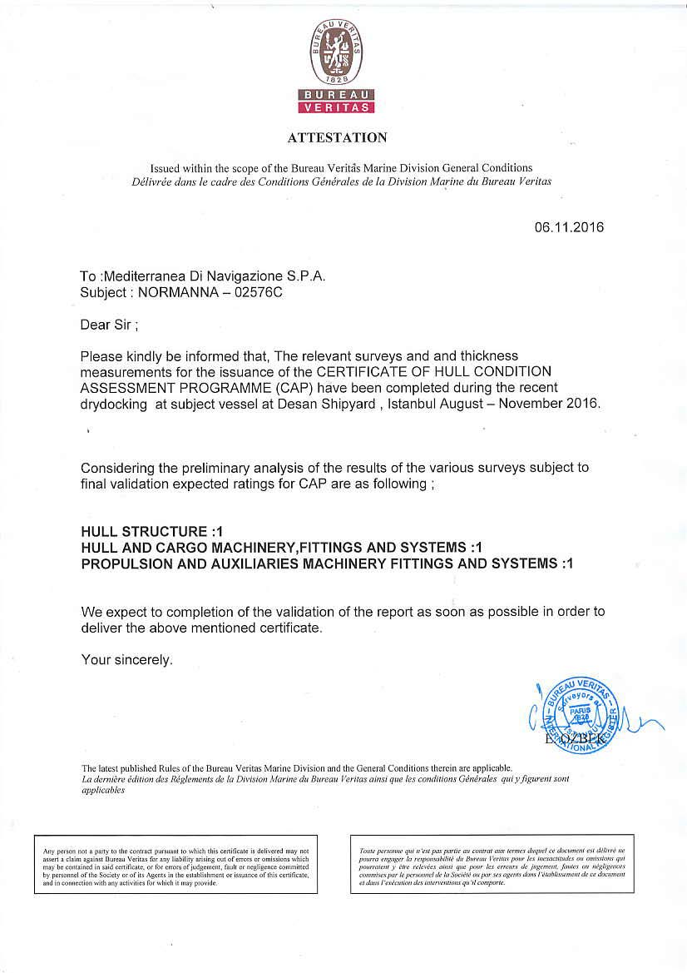

Slide 3
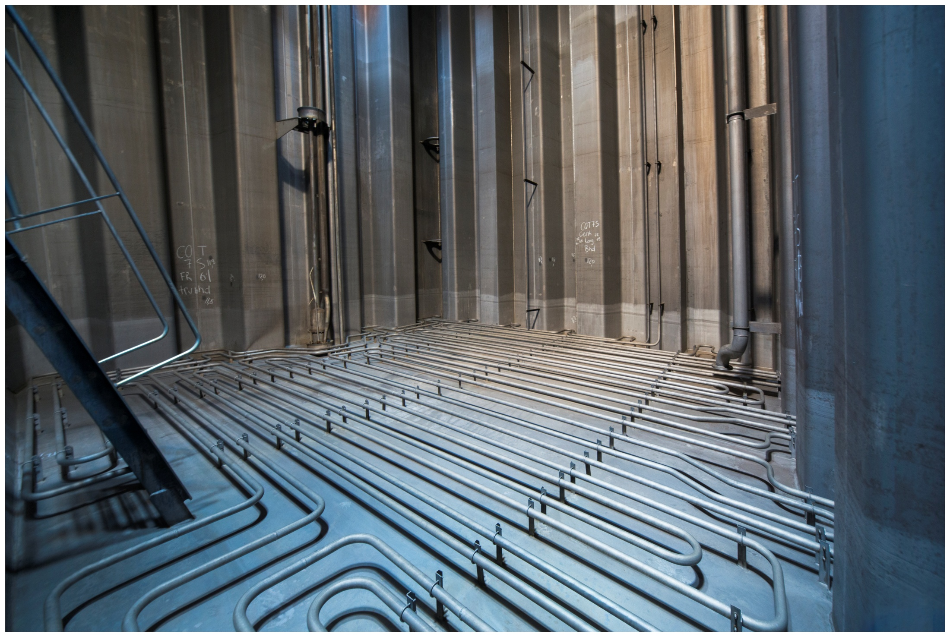

Slide 4
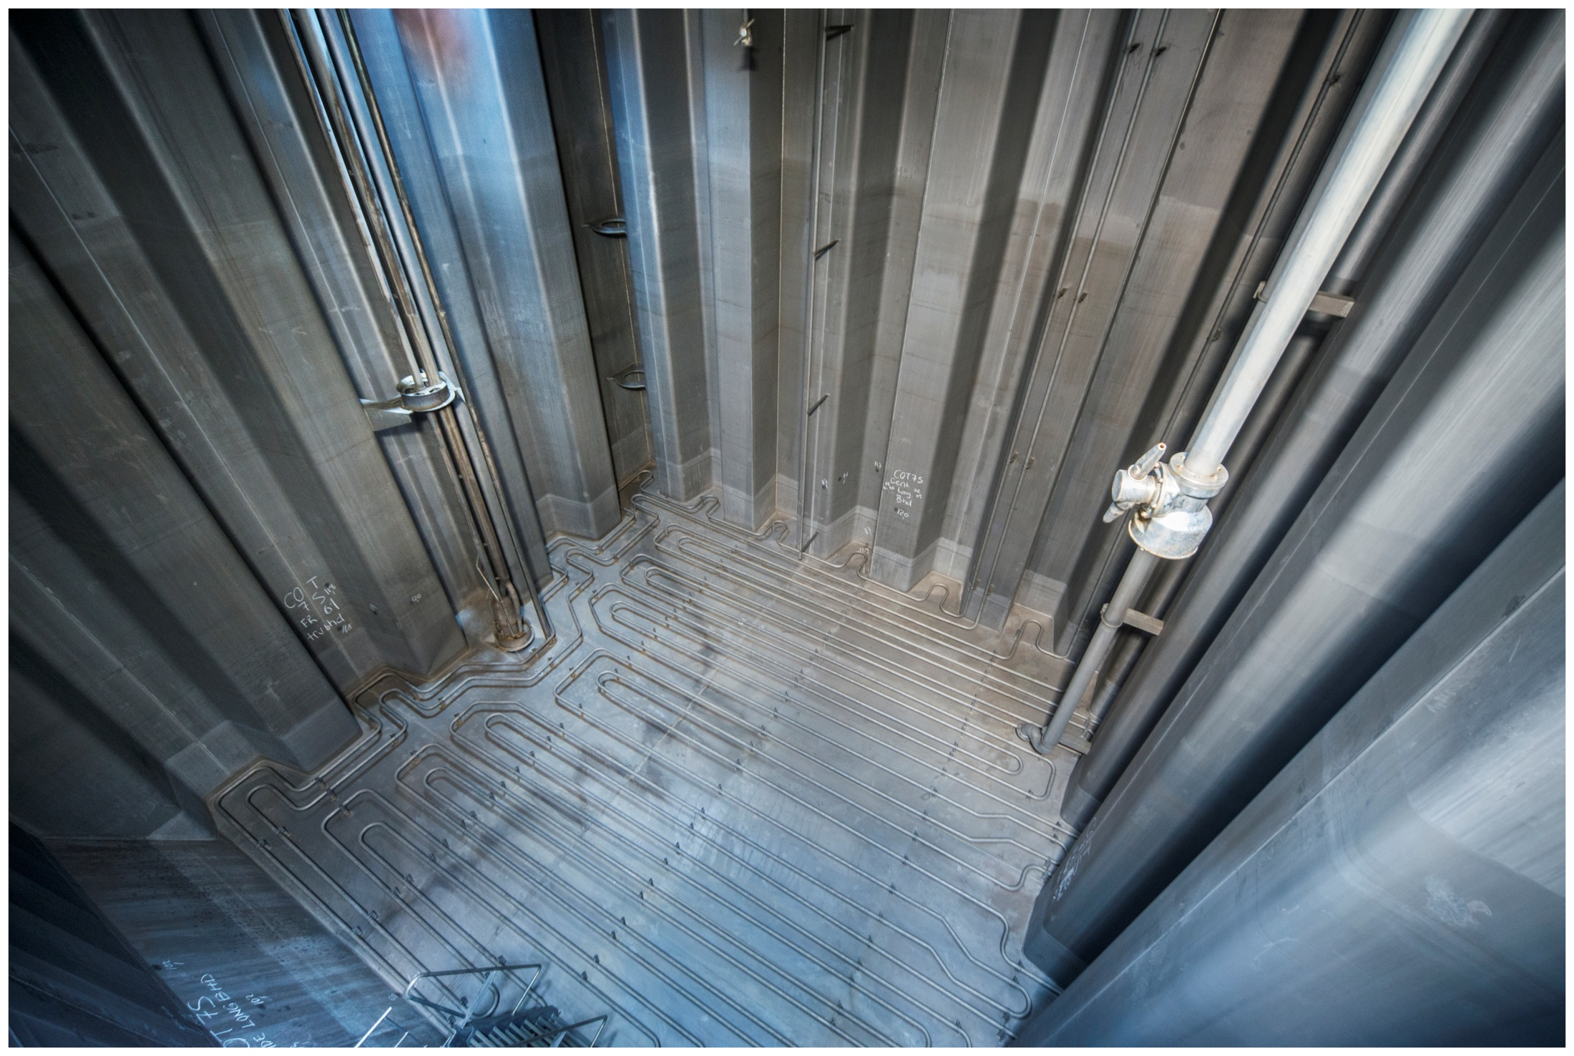

Slide 5
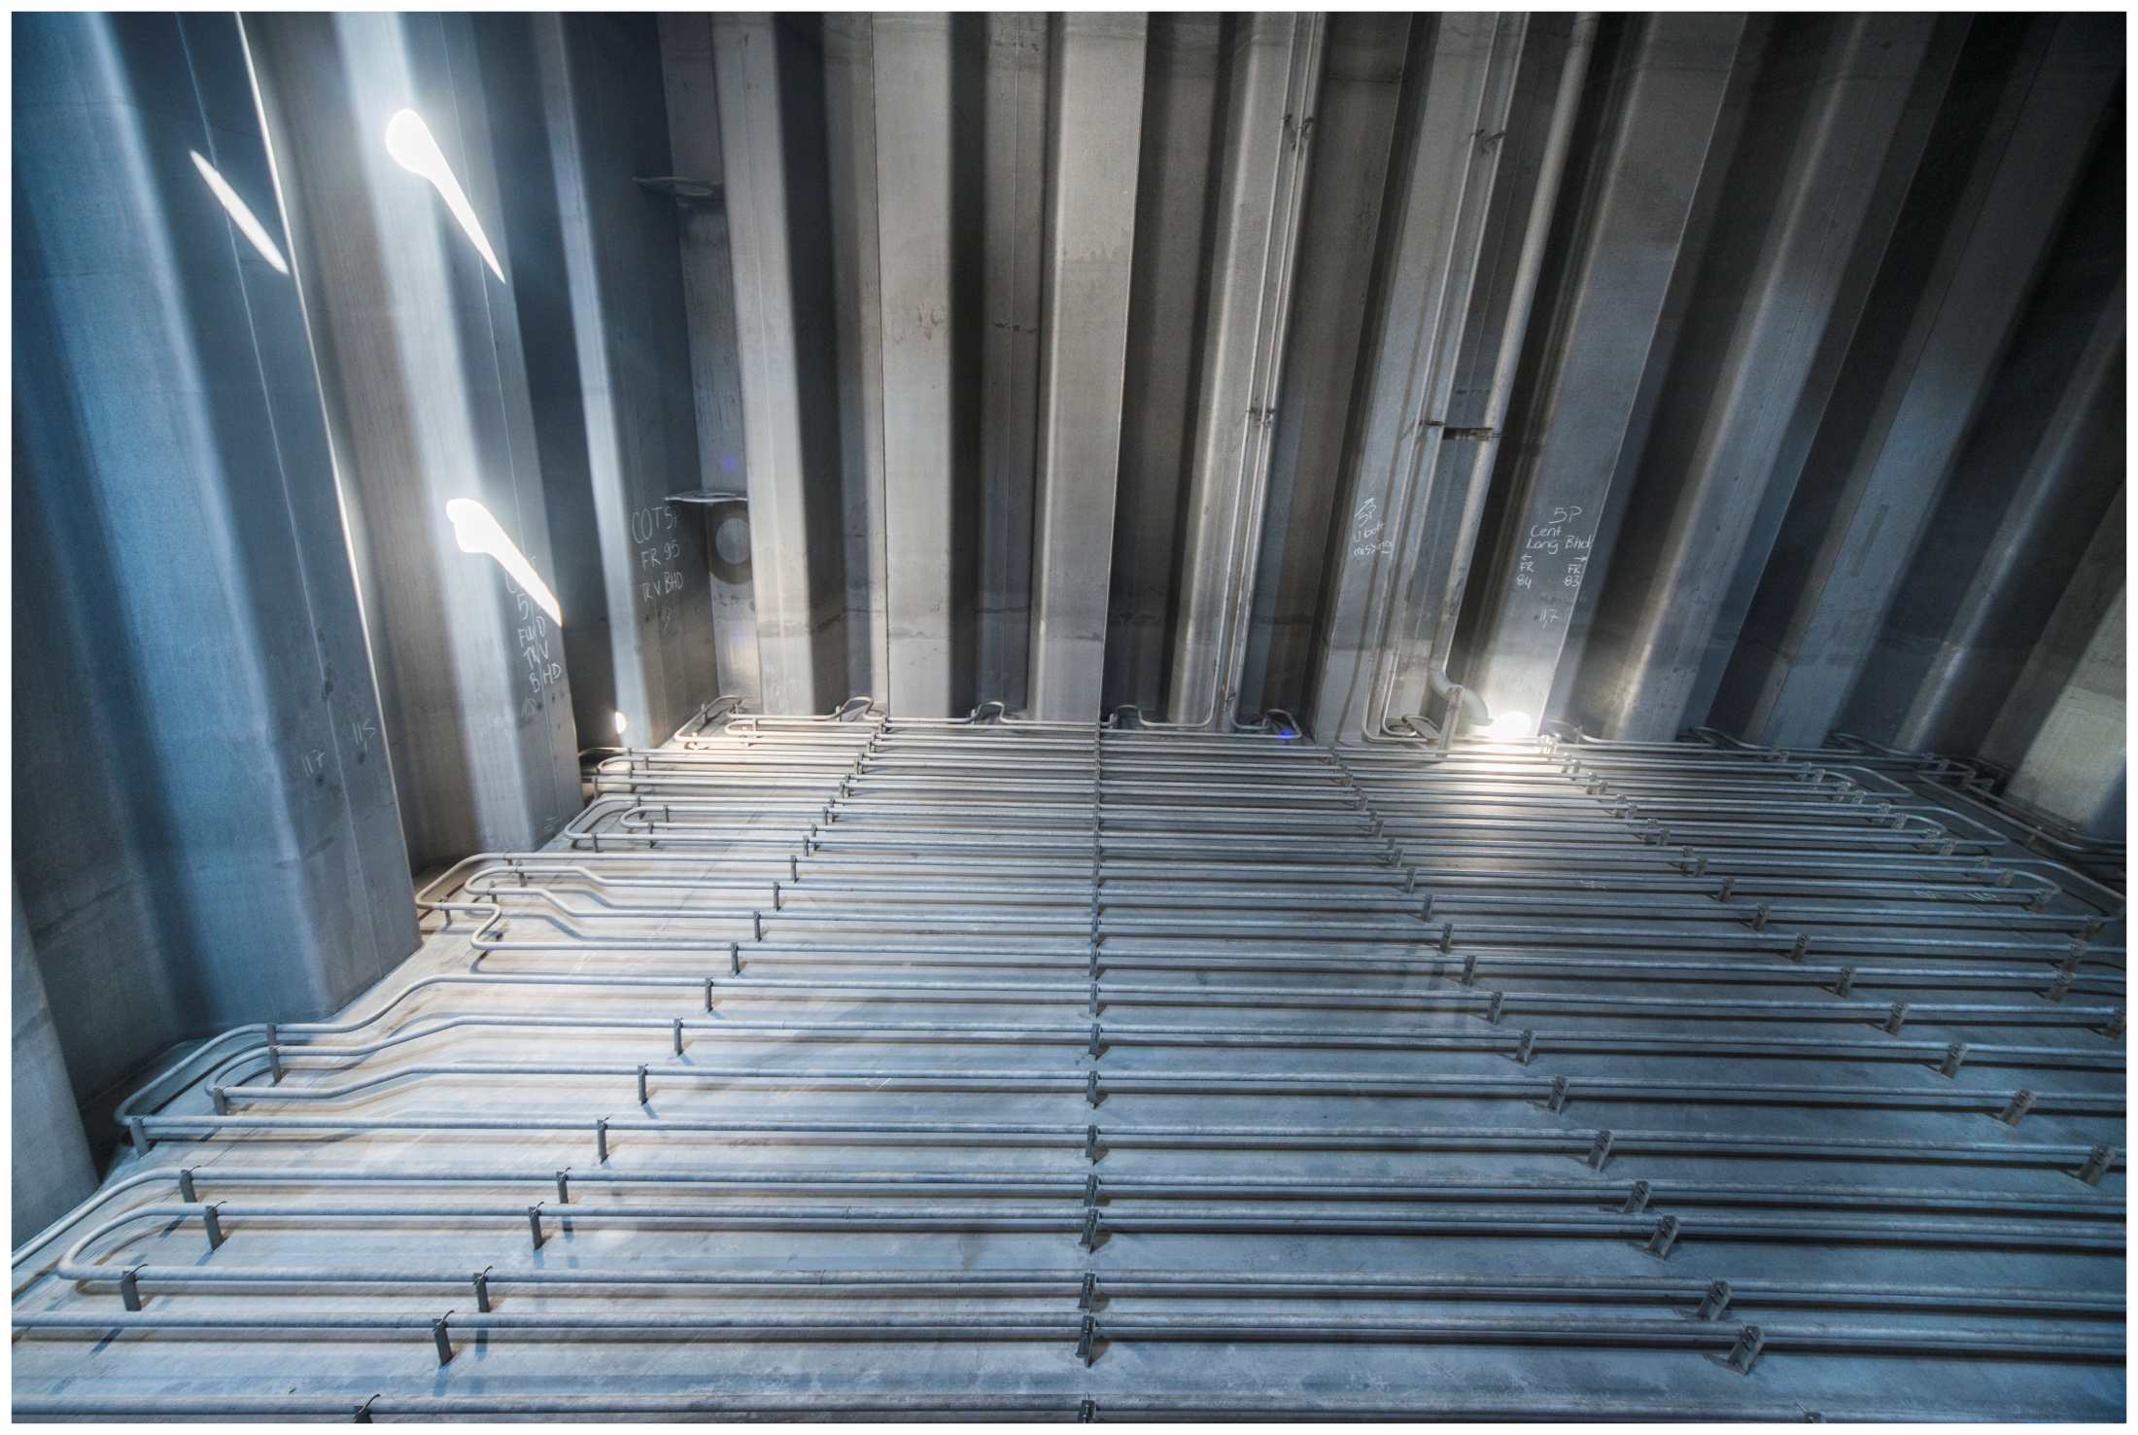

Slide 6
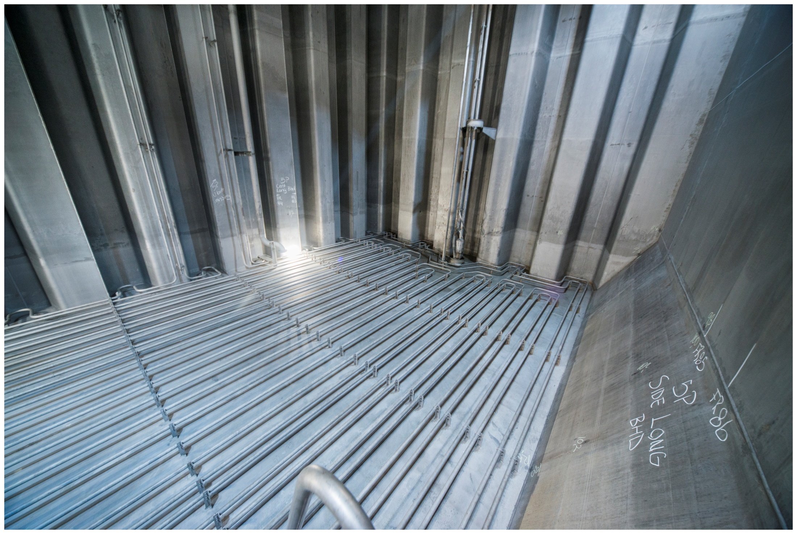

Slide 7
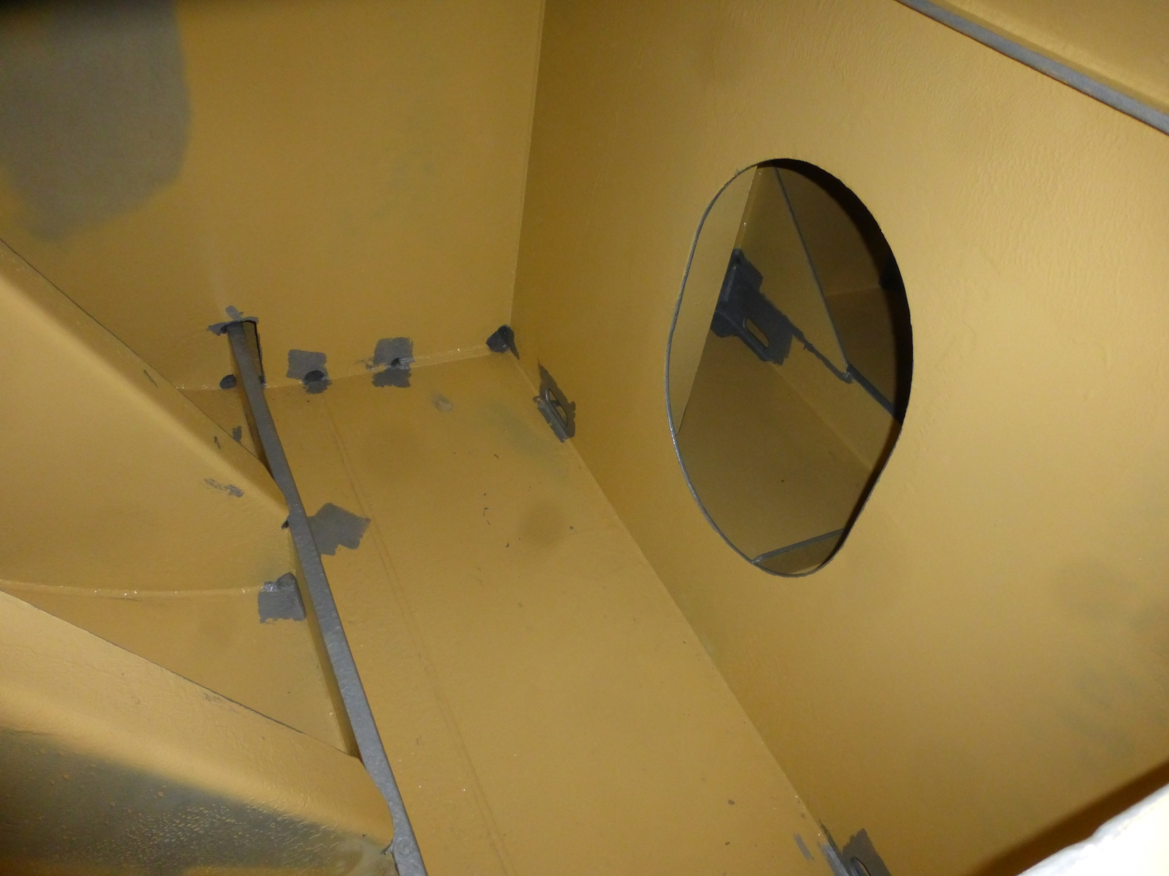

Slide 8
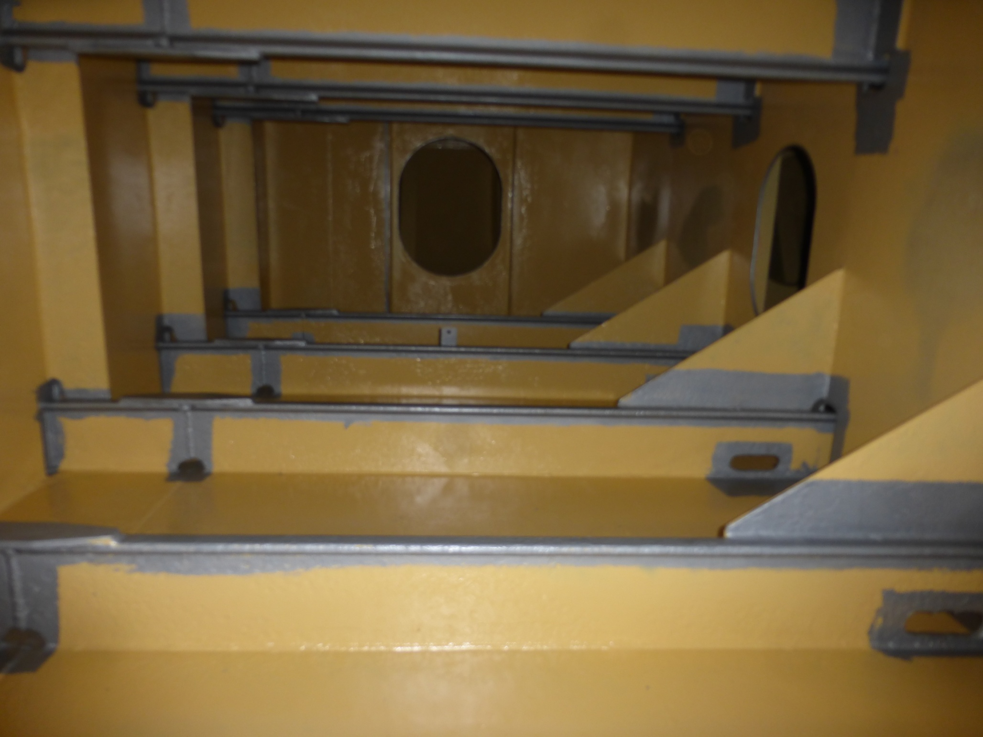

Slide 9
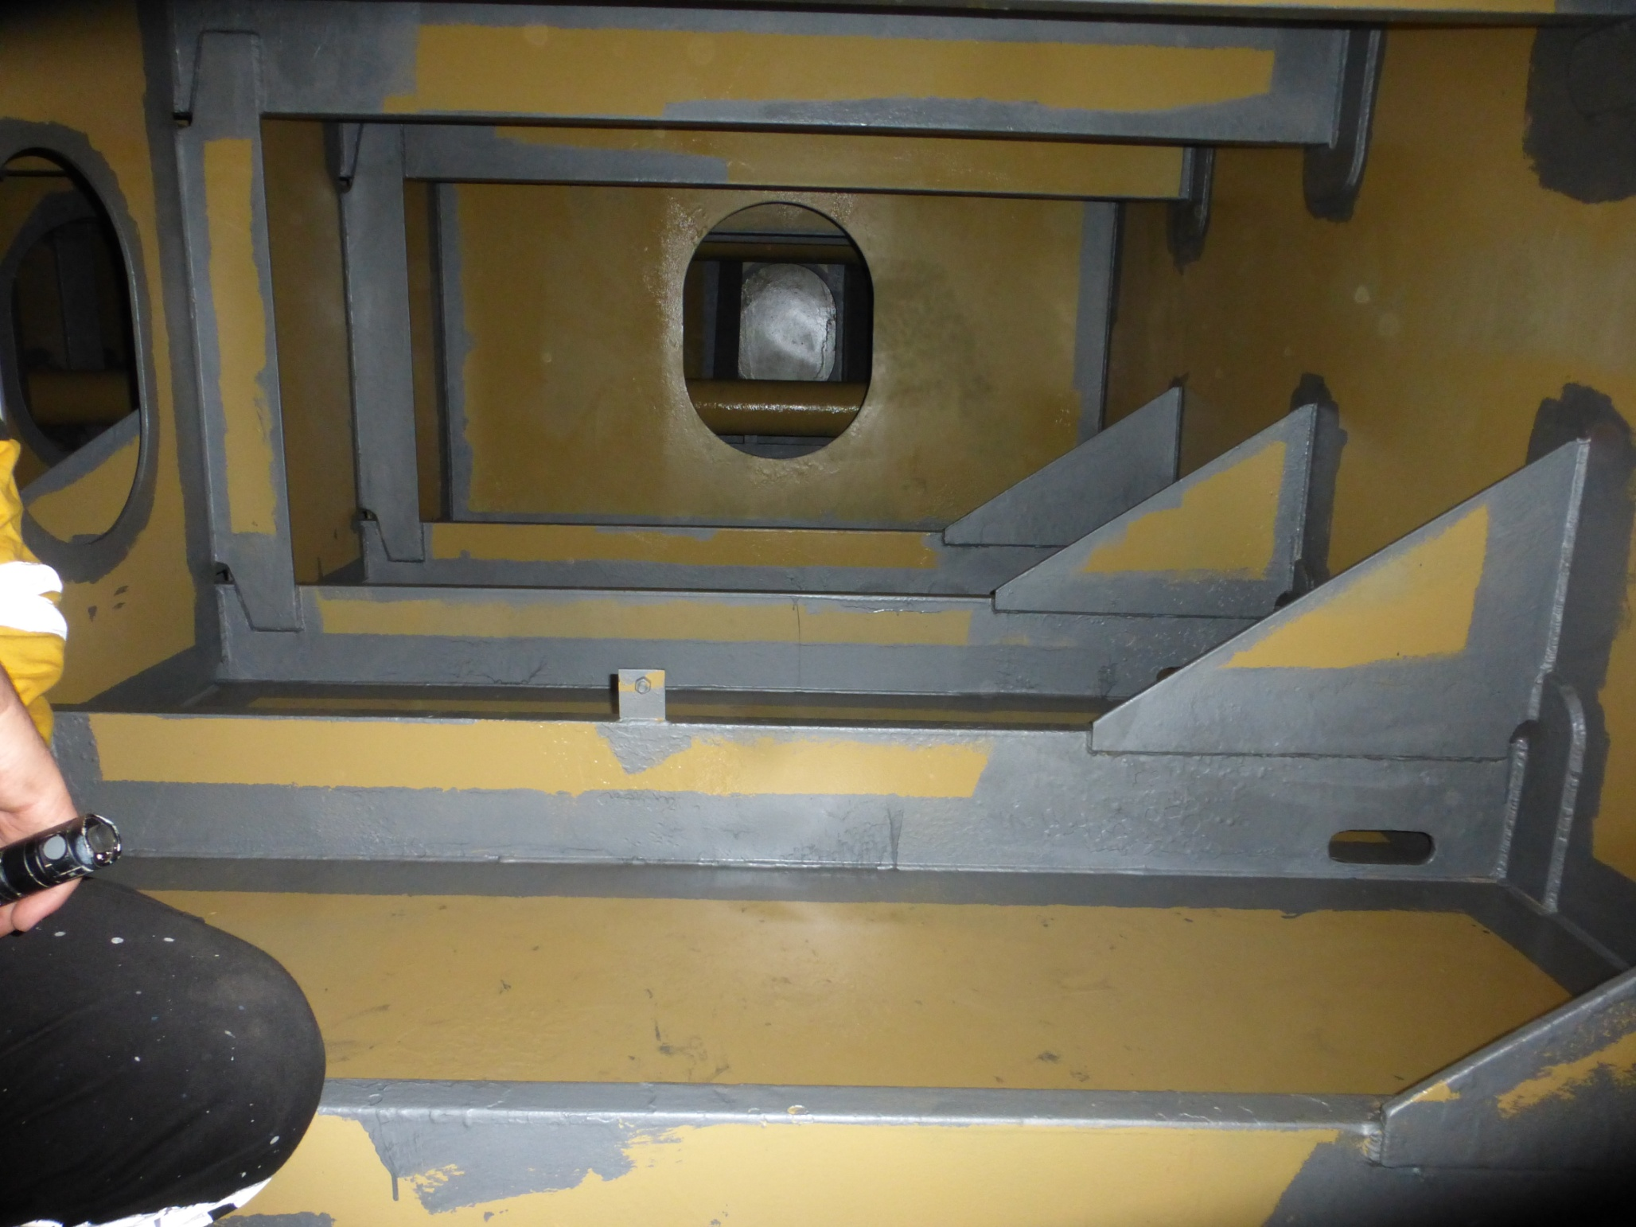

Slide 10
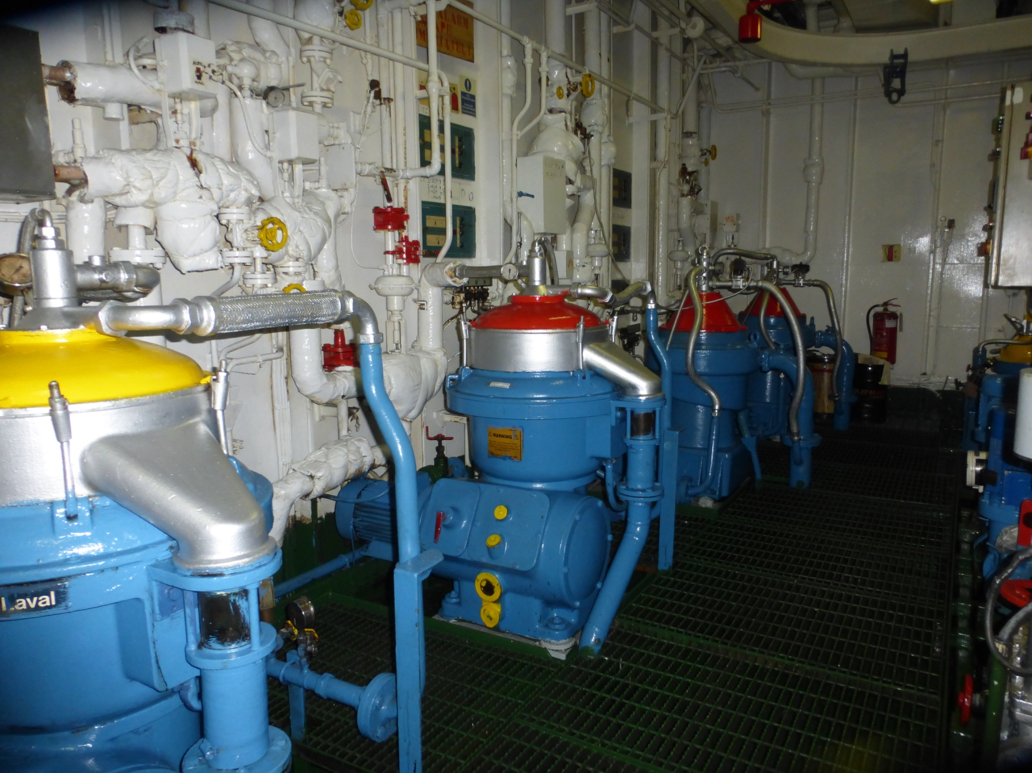

Slide 11
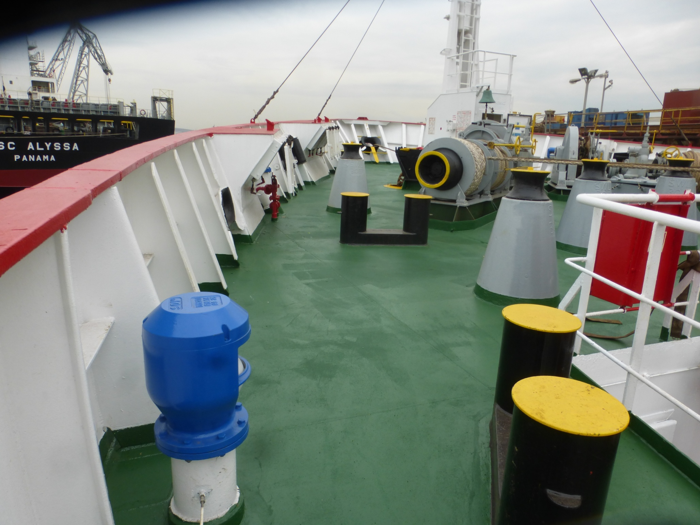

Slide 12
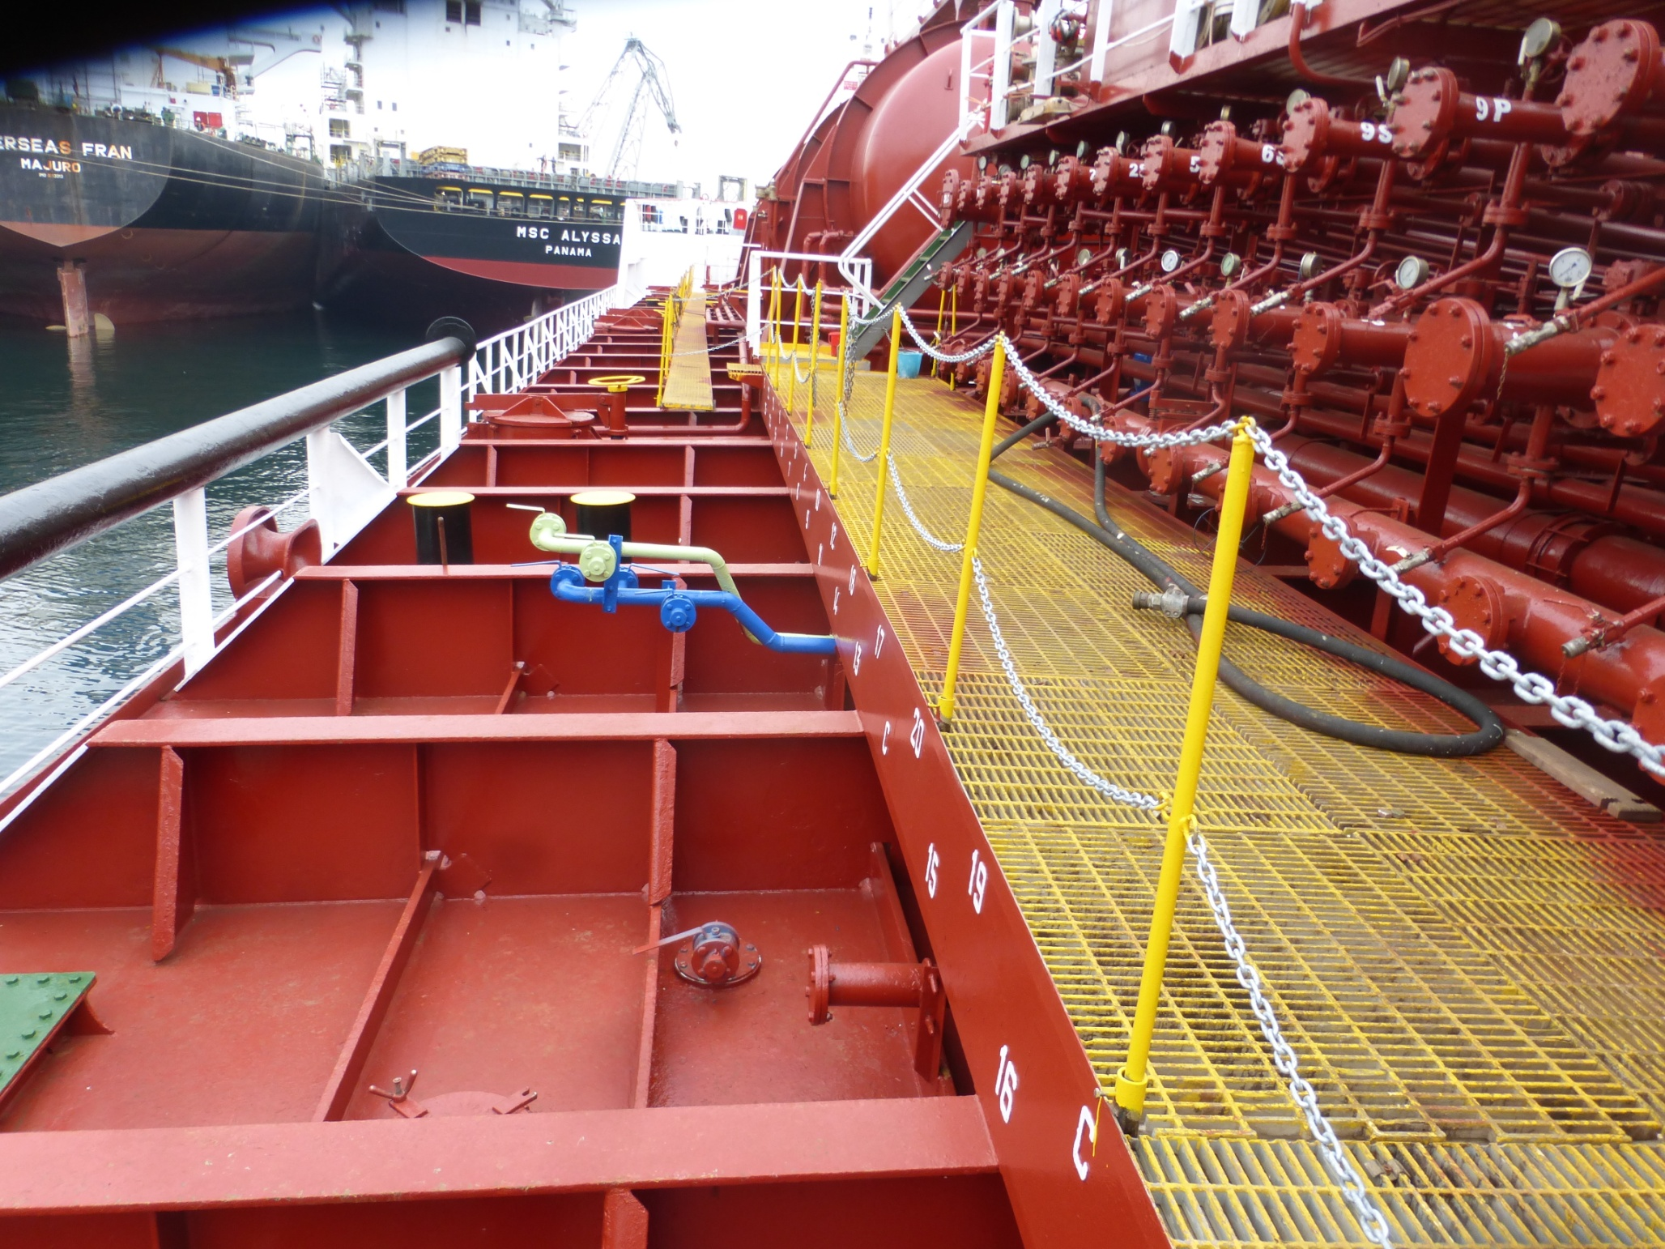

Slide 13
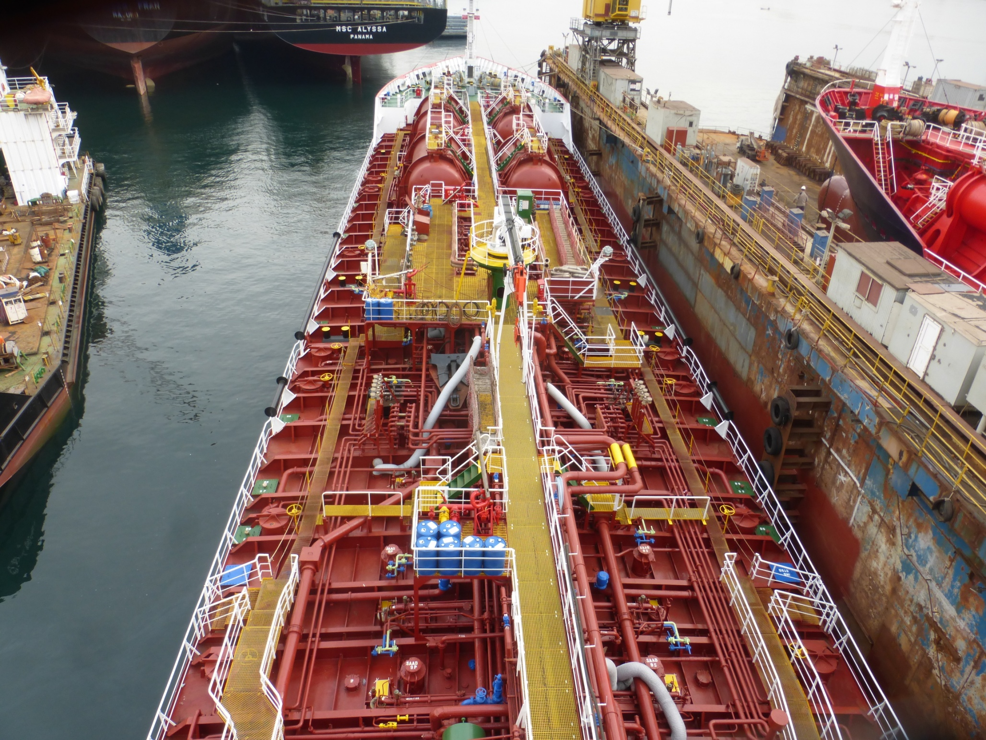

Slide 14
